Slide 1
Cryptographic Protocols

Slide 2
Cryptographic Protocols
Cryptographic protocols are sets of rules that computers follow to communicate safely.
They ensure that when two people (or devices) share information like passwords, messages, or payments it stays private, unchanged, and verified.

Slide 3
What does it do?
A cryptographic protocol helps with:
Confidentiality – Keeps data private
Integrity – Makes sure data isn’t changed
Authentication – Confirms who you're talking to
Non-repudiation – Stops people from denying what they sent

Slide 4
Types of Cryptographic Protocols

Slide 5
1. 🔑 Key Exchange Protocol
These are protocols that allow two parties to safely share a secret key, even over an insecure connection (like the internet).
This key is later used to encrypt and decrypt data
Example:
Diffie-Hellman Key Exchange: Allows two people to agree on a secret key without actually sending the key itself.
RSA Key Exchange: The sender uses the receiver’s public key to encrypt a message; the receiver then uses their private key to decrypt it.

Slide 6
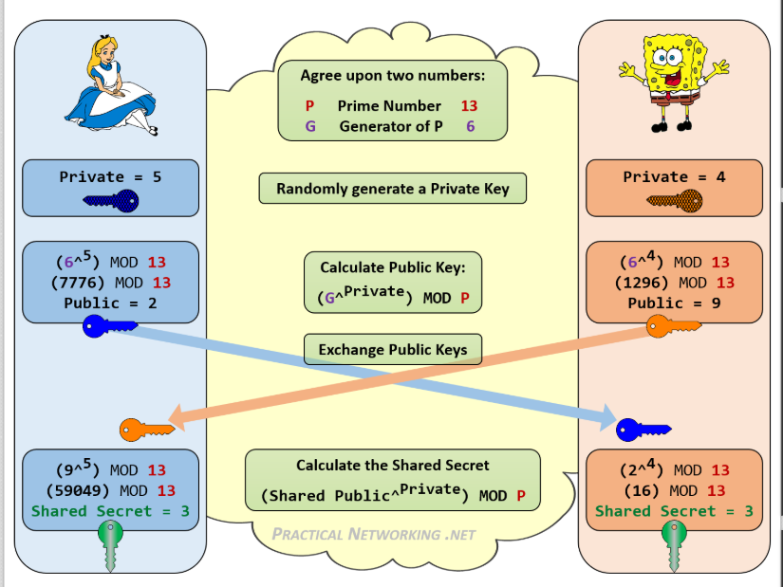
Modular Exponentiation

Slide 7
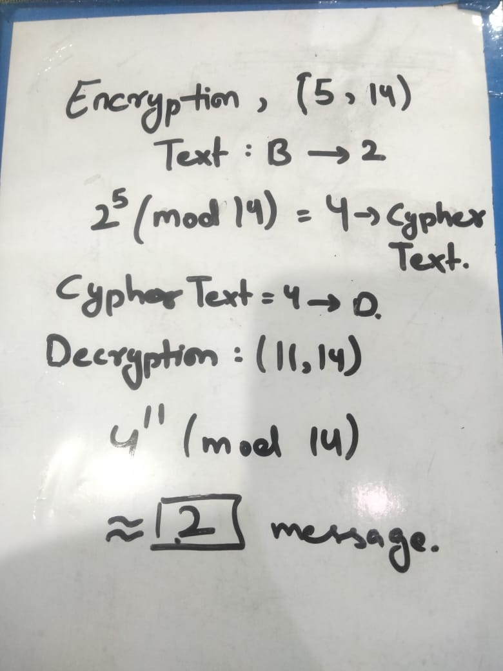
RSA (Rivest, Shamir, and Adleman)

Slide 8
2) Authenticating protocol
These protocols verify the identity of communicating parties.
Think of it like a security checkpoint. You show your ID, and only if it's valid are you let in.
Example:
- Kerberos

Slide 9
Kerberos
Kerberos is a computer security system that allows you to log in once and access many services without typing your password again.
It is a ticket-based authentication protocol. Instead of sending your password around, it uses tickets to prove who you are.
Kerberos is mainly used in:
Big organizations
Schools and universities
Corporate networks

Slide 10
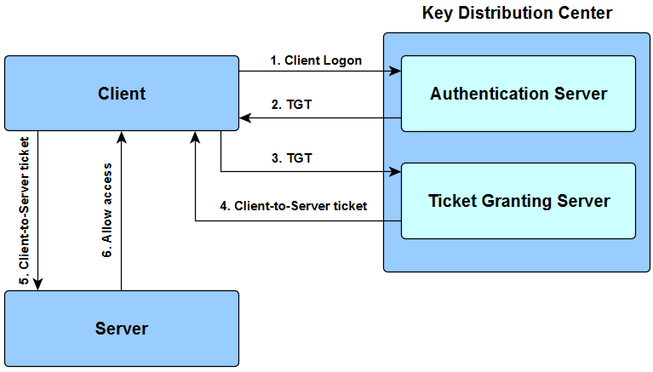
Kerberos

Slide 11
Thank you

